Slide 1
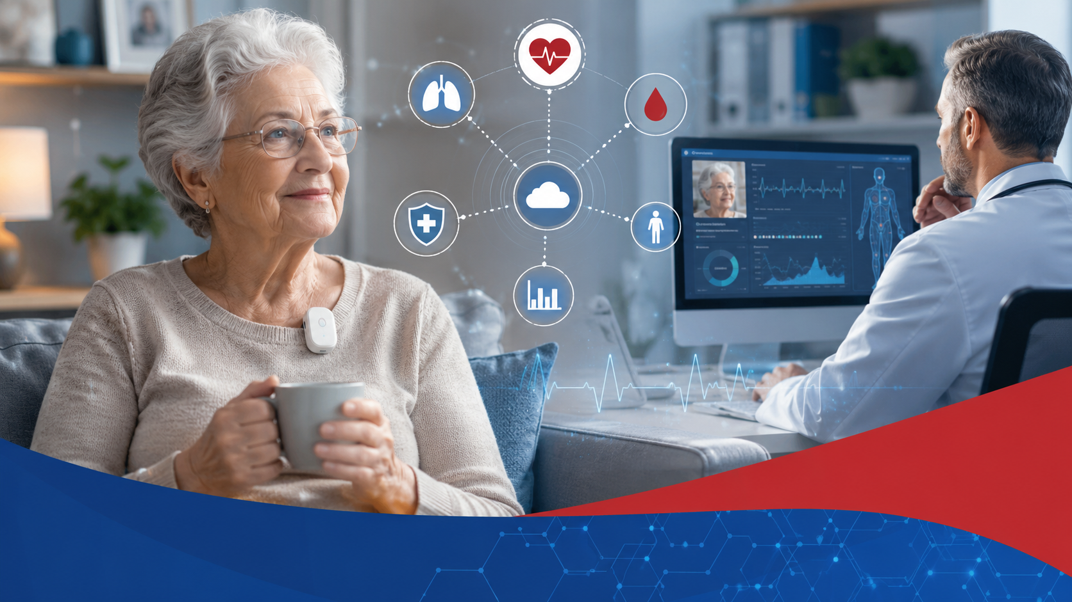
IoT Enabled
Elderly Monitoring
System
Role of privacy preservation frameworks in e-health applications
Vidyadhar J. Aski • Vijaypal S. Dhaka • Sunil Kumar • Anubha Parashar
Healthcare IoT | Remote vitals monitoring | Security and privacy

Slide 2
Paper snapshot
Presented work
“IoT enabled elderly monitoring system and the role of privacy preservation frameworks in e-health applications”
The paper frames Healthcare IoT as an e-health paradigm where biosensors capture body vitals and transfer data through wireless infrastructure to a data center.
Core keywords: HIoT, interoperability, e-health, access control, authentication.
Manipal University Jaipur
02

Slide 3
Motivation and research gap
Why this work matters
Remote care is becoming essential
Elderly patients and people with chronic or degenerative conditions need continuous observation outside hospital settings.
Healthcare IoT offers the backbone
Wearable and home-based biosensors can monitor temperature, heart rate, blood pressure, glucose, oxygen and movement patterns.
Privacy decides adoption
Health data is sensitive. Trust depends on authentication, access control, secure transmission and clear governance around sharing.
03

Slide 4
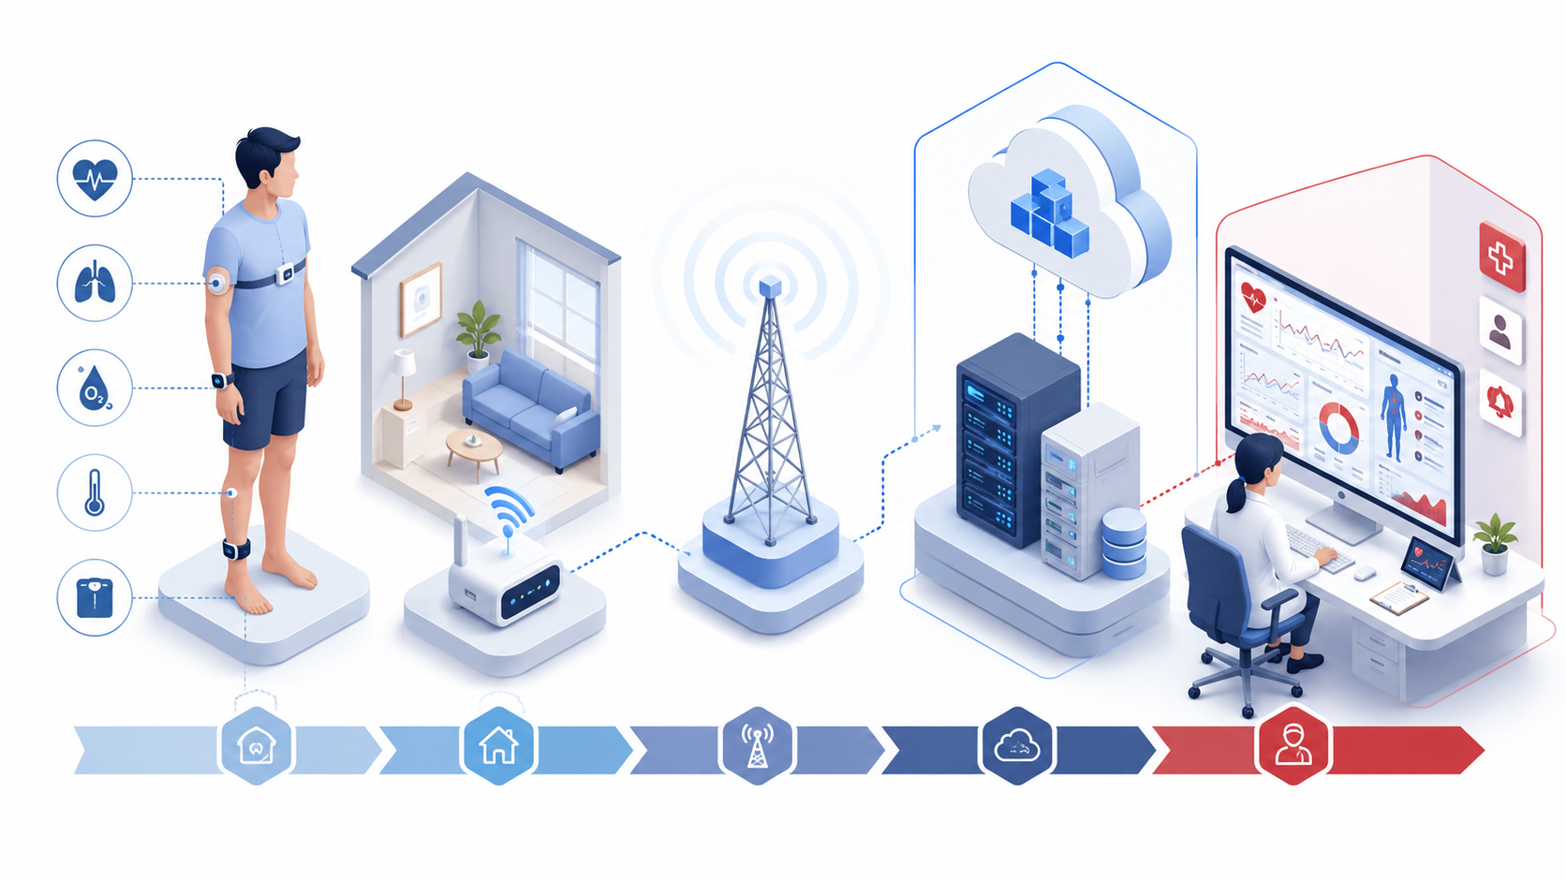
From home vitals to clinical response
Proposed HIoT monitoring flow
1
Sense
2
Transmit
3
Consolidate
4
Act
Vitals from biosensors
Wireless gateway + network
Cloud / data center storage
Doctor, caregiver, alerts
04

Slide 5
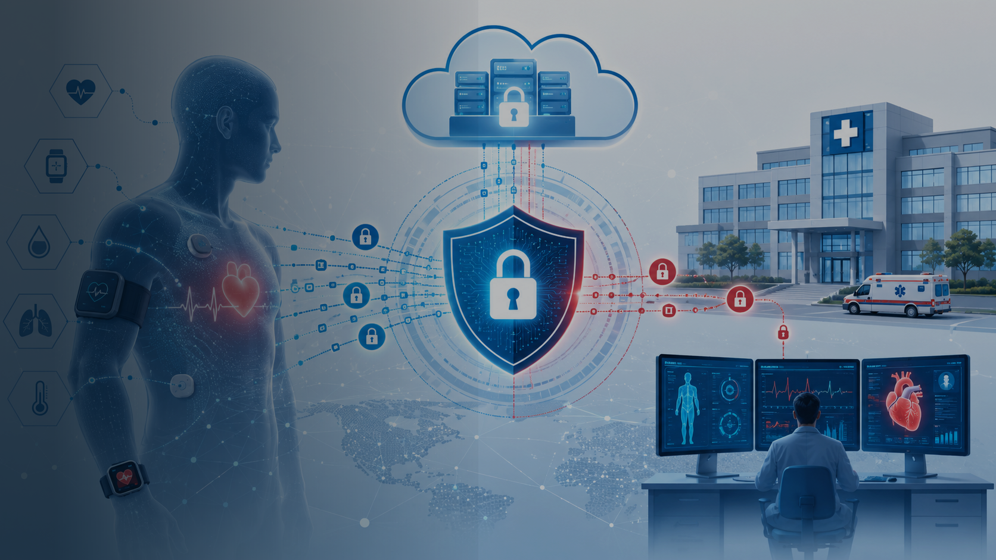
Privacy preservation
framework: what must be protected
The paper positions security and privacy as a core design requirement, not an add-on after deployment.
Authentication
Verify devices, users and care providers before access.
Access control
Grant data privileges based on role, consent and need.
Secure data flow
Protect sensor-to-cloud transmission and storage.
Interoperability
Enable safe data exchange across devices and systems.

Slide 6
A useful structure for presenting the paper
Research contribution
Overview of HIoT trends
01
Summarises how IoT supports e-health sensing, communication and data delivery.
Privacy preservation focus
02
Discusses security issues around healthcare data and connected devices.
Architecture proposal
03
Introduces a framework for monitoring vitals of differently abled or chronic-care patients.
Use-case scenarios explain how components interact in real care situations.
06

Slide 7
Translating the framework into practice
Use-case scenarios and expected outputs
Scenario
Trigger
Output
Routine monitoring
Vitals stay within range
Daily trend dashboard and care summary
Anomaly alert
Sudden change in vitals or fall signal
Immediate alert to caregiver/doctor
Clinical review
Doctor checks patient history securely
Role-based access to relevant records
Emergency escalation
Critical threshold crossed
Priority notification and response workflow
Core message: accurate sensing is only valuable when the data flow is trusted, secure and useful to caregivers.
07

Slide 8
Presentation
summary
A conference presentation on designing trusted Healthcare IoT systems for elderly and chronic-care monitoring.
1
HIoT connects biosensors, communication networks and care providers.
2
Privacy preservation is a core requirement for adoption.
3
The architecture supports monitoring, alerts and secure clinical review.
Thank you
Anubha Parashar

